Slide 1
I/O Psychology Chapter 6 – Staffing Decisions
AKA Selection

Slide 2
Overview
Modules 6.1 & 6.3 – Conceptual & Practical Issues in Staffing
Module 6.2 – Evaluation of Staffing Outcomes
Module 6.4 – Legal Issues in Staffing Decisions

Slide 3
Modules 6.1 & 6.3 – Conceptual & Practical Issues in Staffing

Slide 4
What is a Staffing decision?
Decision associated with recruiting, selecting, promoting, & separating employees
Stakeholders

Slide 5
Staffing from International Perspective
Job descriptions used universally
Educational qualifications & application forms widely used for initial screening
Interviews & references are common post-screening techniques
Cognitive ability tests used less frequently; personality tests used more frequently

Slide 6
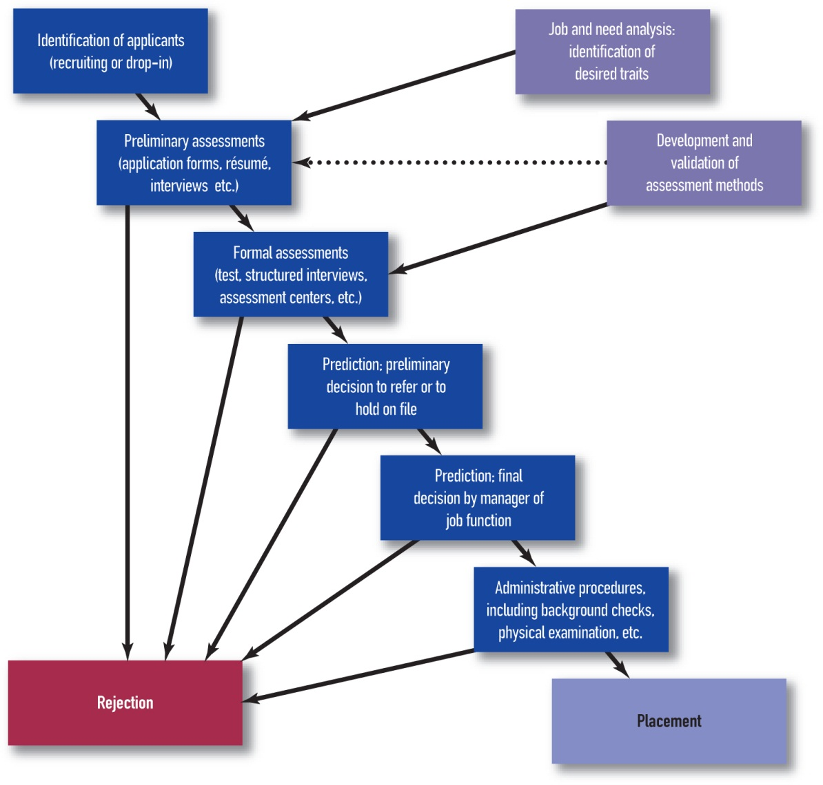
The Staffing Process

Slide 7
Impact of Staffing on Firm Performance
High-performance work practices
Include use of formal job analyses, selection from within for key positions, amount of training received by employees, merit-based promotions, & use of formal assessment devices for selection
Term has ___________________________
Staffing practices have positive associations with firm performance

Slide 8
Selection vs. Placement
Selection
Measuring individual differences and hiring based upon them
Example: Any modern organization
Placement
Measuring individual differences that are already hired and placing them in the job best for them
Example: US Army

Slide 9
General Staffing Concerns
Choice of assessment methods
Combining assessment methods
Determine incremental validity of selection instruments
Determine a selection ratio
Determine utility

Slide 10
Typical Selection Methods – Review
Questionnaires/Measures/Tests
Assessment Centers
In-baskets, leaderless group discussions, oral presentation, etc.
Measuring traits across exercises
Interviews
Structured vs. unstructured interviews
Biodata (the method)
Realistic Job Previews
Work Sample Tests / situational judgment tests (SJT)
Internet-based Testing

Slide 11
Combining Information
_____________________ decision making
Uses judgment to combine information
“Intuitive” method – decision maker examines multiple pieces of information, weights them in his/her head, and makes a decision
_____________________ decision making (“actuarial”)
Uses mathematical formula to combine information
Which approach would you expect to be associated with more accurate decisions/predictions?
A = holistic, B = mechanical

Slide 12
Combining Information
Compensatory systems
Additive systems
Optimal weighting systems (multiple regression)
y‘ = 5.3 + 1.6*(GMA) + 2.5*(Conscientiousness)
Hurdle systems
Ordering of hurdles matters
Usually only appropriate when
a specific number of positions is available, or
an empirically validated selection system would cost too much to administer to every applicant, or
to prevent cheating

Slide 13
Problems with Compensatory Systems
Can sometimes create undesirable combinations of traits
Dishonest, Intelligent
(potentially hired)
Honest, Intelligent
(definitely hired)
Integrity
Dishonest,
Not as Intelligent
(not hired)
Honest,
Not as Intelligent
(potentially hired)
GMA

Slide 14
Problems with Hurdle Systems
Hurdle System 1 (Consc. 50% > GMA 50%)
Cuddy and Wilson survive first stage
Wilson is hired
Hurdle System 2 (GMA 50% > Consc. 50%)
House and Chase survive first stage
House is hired
Candidate | Conscientiousness | GMA
G. House | 1.5 | 2.3
L. Cuddy | 5.4 | 1.2
J. Wilson | 3.1 | 1.3
R. Chase | 1.2 | 1.6

Slide 15
Combining Information
Score Banding
Individuals with similar test scores are grouped together & selection from category is made based on other information
Scores within a standard error of measurement (SE)
Creation of bands complex
Controversial
Subgroup Norming
Develops separate lists/rankings for individuals within different demographic groups
Illegal under Civil Rights Act of 1991

Slide 16
Establishing Cut Scores
___________________________: established by considering desired level of performance and finding the test score that correspond to the desired level of performance
___________________________: based on some index of the test takers’ scores (e.g., percentage)
Use criterion-referenced cut scores
Specified by Uniform Guidelines
Lanning v. SEPTA – norm-referenced cut scores fare poorly

Slide 17
Deselection
Termination for cause – fired for wrongdoing or poor performance
Usually have warning
Perceptions of fairness less important
Layoff – fired due to downsizing or reductions in force
Often comes without warning
Perceptions of fairness important
Should use statistical combinations

Slide 18
Number of Decisions
Large Staffing Projects
E.g., TSA and Large Police Departments
Need efficient screen out tests
Small Staffing Projects
Local coffee shop or family owned restaurant
Can use wider range of selection methods
Need valid selection system regardless

Slide 19
Module 6.2 – Evaluation of Staffing Outcomes

Slide 20
Three ways to evaluate
Validity
Utility
Fairness

Slide 21
Incremental Validity
Benefit to criterion-related validity to use one set of predictors over another set
Predictive overlap in predictors is not cost effective, if avoidable
Job Performance
GMA
Job History
Integrity

Slide 22
Testing for Criterion-related Validity
Simple zero-order correlation matrix
Does not give overall criterion-related validity estimate across all predictors
Multiple regression
R²/coefficient of multiple determination: proportion of variability in the criterion explained by the predictors
Testing for __________________
Hierarchical multiple regression
Run multiple regression testing model fit of your initial set of predictors (R²)
Run multiple regression testing model fit of your initial set of predictors plus your new predictors (R²)
Check if there is a difference in R²s (ΔR²)

Slide 23
Hierarchical Multiple Regression and Incremental Validity Example
Correlations
C v. JP: r = 0.22 (r² = 0.05)
g v. JP: r = 0.39 (r² = 0.15)
Integrity v. JP: r = 0.35 (r² = 0.12)
Model 1: I + g
R² = 0.30
Model 2: I + g + C
R² = 0.31
ΔR² = 0.01

Slide 24
Selection Strategies and Concerns
5
Hires
10
Offers
40
Interviews
50
Invites
100
Leads

Slide 25
Selection Ratio
Index of ultimate goals of hiring
Ratio of number of positions/hires to number of applicants
Example: 10 positions for 100 applicants: u = 0.1
Importance
The more difficult it is for any individual to be hired, the bigger the difference between average hired and not-hired job performance will be

Slide 26
Selection Ratio and Cut Scores
Criterion-related Validity
Desirable Performance Level
JP
Cut Score
Predictor

Slide 27
Which is worse???
A = Hiring someone who ends up being a bad employee
B = Not hiring someone who would have been been a good employee
Would your answer change based on the job?
A = Yes, B = No

Slide 28
Selection Decisions
_____________
Applicant accepted but performed poorly
_____________
Applicant rejected but would have performed well
_____________
Applicant accepted & performed well
_____________
Applicant rejected & would have performed poorly

Slide 29
Selection Ratio and Cut Scores
False
Negatives
Good Hires
JP
False
Positives
Good
No-Hire
Predictor

Slide 30
Selection Ratio and Cut Scores
False
Negatives
Good Hires
JP
False
Positives
Good
No-Hire
Predictor

Slide 31
Selection Ratio and Cut Scores
False
Negatives
Good Hires
JP
False
Positives
Good
No-Hire
Predictor

Slide 32

Utility of a Selection System
Utility in I/O = ROI in Business
Increase Utility from Selection Systems by:
Testing more applicants / hiring fewer people
Reducing cost of assessment per person
Using assessment procedures with high validity
Also affected by:
SD of JP
N_{s} = # selected
r_{yx} = validity coefficient
s.r. = selection ratio
λ = height of standard normal curve at selection cutpoint
C = Cost/person of testing
$D_{y} = SD of performance in dollars

Slide 33
Utility
False
Negatives
Waste of $
Good Hires
JP
False
Positives
Waste of $
Good
No-Hire
Predictor

Slide 34
Maximum Utility
JP
Predictor

Slide 35
Feelings of unfairness regarding Staffing Strategies can lead to:
Initiation of lawsuits
Filing of formal grievances with company representatives
Counterproductive work behavior

Slide 36
Module 6.4 – Legal Issues in Staffing decisions

Slide 37

Legal Issues in Staffing Decisions
Charges of employment discrimination
Involve violations of Title VII of 1964 Civil Rights Act, the Age Discrimination in Employment Act of 1967 (ADEA), or the Americans with Disabilities Act of 1990 (ADA)
I-O psychologists often serve as expert witnesses in these lawsuits
Consequences can be substantial
Most often brought by individual claiming unfair termination

Slide 38
Employment Discrimination
Title VII of the Civil Rights Act of 1964
Established unlawful employment practices on basis of 5 protected groups:
Race
Gender
Religion
Color
National origin
May not fail to or refuse to hire, or discharge based on the basis of any of the 5 groups
May not separate or classify on the basis of any of the 5 groups
Employment advertising and training preferences may not indicate preferences for any group

Slide 39
Employment Discrimination
ADEA
Extended the same legal protection granted to the 5 groups to people aged 40 and over
ADA
Reasonable accommodation
Employers are required to modify or accommodate their business practices in a reasonable fashion to meet the needs of disabled persons
e.g., providing elevators or ramps, providing readers, etc.

Slide 40
Costly Risk to Ignore
Scharf & Jones (2000)
Texaco, 1996 $176,100,000 for RACE
Shoney’s, 1993 $105,000,000 for RACE
Home Depot, 1997 $65,000,000 for SEX
Hooters, 1997 $3,750,000 for SEX
Lockheed-Martin, 1996 $14,000,000 for AGE
Coca-Cola, 1995 $7,100,000 for DISABIL

Slide 41
Theories of Discrimination
____________________________________
Intentionally applying a standard or practice (e.g. hiring, training) to one group but not another
__________________________
A standard or procedure (e.g., hiring) is applied equally to all, but disproportionately (and unintentionally) excludes a higher proportion of one group than another.

Slide 42
Standards
Equal Employment Opportunity Commission (EEOC)
Established the Uniform Guidelines on Employee Selection Procedures (1978)
Gave a practical and easy to compute method to determine AI – the 4/5ths Rule

Slide 43
4/5ths Rule
Passing rate of protected class must be no less than 4/5ths of the passing rate for the non-protected group
Compute an odds ratio:
Selection Ratio of Discriminated Group divided by Selection Ratio of Non-Discriminated Group
Compare odds ratio with 4/5 (0.8)
Non-Discriminated Group defined by Discriminated Group (i.e. compare women with men, African Americans with European Americans, etc.), all within a protected class

Slide 44
4/5ths Rule Example
Applicant pool Hired
40 European Amer. 18 European Amer.
30 African Amer. 12 African Amer.
Steps
Compute selection ratios
18/40 = 0.45
12/30 = 0.4
Compute odds ratio
0.4 / 0.45 = 0.89
Compare to 0.8

Slide 45
If Adverse Impact is suspected…
Plaintiff’s lawyer petitions judge for records that would indicate adverse impact from the defendant organization
Plaintiff (or plaintiff’s legal team) demonstrates AI (using 4/5ths rule, for example) & that plaintiff is member of protected class
Company must then demonstrate:
The test is job related (through demonstration of content validity, criterion-related validity, or BFOQ).
There is no alternate valid, job-related test with less AI that could have been used.

Slide 46
Legal vs. Illegal Discrimination
Job of “Bag Lifter” requires lifting 100 lb. bags and moving them 10 feet.
Only assessment for hiring is a work sample.
Selection procedure shows adverse impact against women.
Is it legal?

Slide 47
Common Mistakes Regarding AI
Company hires 5 women and 80 men.
Is there adverse impact?
Equating adverse impact with bias
Misinterpreting mean differences
“Women, on average, score lower than men” does not mean “all women score lower than all men” nor “this woman won’t score well”

Slide 48
It is illegal to use a selection practice that discriminates against women.
True
False

Slide 49
It is illegal for an employer to use a medical test (such as MMPI for mental illness).
True
False

Slide 50
It is illegal to fire someone at age 65.
True
False

Slide 51
It is illegal to hire more whites than Latinos if your company is in a Latino neighborhood.
True
False

Slide 52
It is legal to consider an applicants’ physical disability in the hiring process.
True
False

